Slide 1
On!Purpose
People Management
Trends . Traits . Trajectory

Slide 2
Q&A
Please Send: Questions, Comments, Discussion to…
Email:
OnPurposePM@gmail.com
LinkedIn > Group
People Management: On!Purpose

Slide 3
Affect
Triple Bottom Line in People Management
Passion
Productivity
Profit

Slide 4
Trends

Slide 5
Economic Eras
History
Purpose
Information
Industrial
Agrarian

Slide 6
Source:
Imperative.com
Purpose Economy

Slide 7
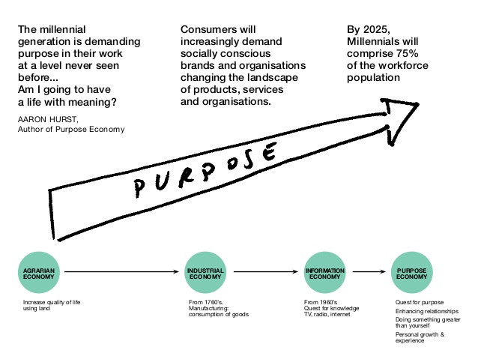
Source:
“The Purpose Economy”, Hurst

Slide 8
Purpose: The Integral Part of Existence
Personal
Organizational
Role
Triple Bottom Line
Define
Decide
Develop
Job
Career
Purpose
Sweet
Spot
Ethical
Deliver
Serve
Delight
Engage
Source:
“The Purpose Effect”, by Pontefract

Slide 9
Shared Value
Defined
‘Shared Value: Corporate policies and practices that enhance competitiveness of the company while simultaneously advancing social and economic conditions in the communities in which it sells and operates.’
- Porter, 2012

Slide 10
Source: Porter, 2012

Slide 11
Source: Porter, 2012

Slide 13
Innovation
Collaboration
Collaboration
Collaboration
Collaboration
.
Five Pillars
21st Century Economy
Technology
Wealth Distribution Balancing Act
Business Models
Non-Traditional Go-to-Market
Strategies

Slide 15
Prominent Authors
Common Thread
Neelly
Senge
Porter
Systemic Movement
Economic Movement
Hurst
Pauli
Scharmer

Slide 16
Traits

Slide 18
10 Year Focus
Source: Bersin by Deloitte

Slide 19
by: R. Strack
2030 Major
Workforce Crisis
Source: Adapted from Bersin by Deloitte

Slide 20
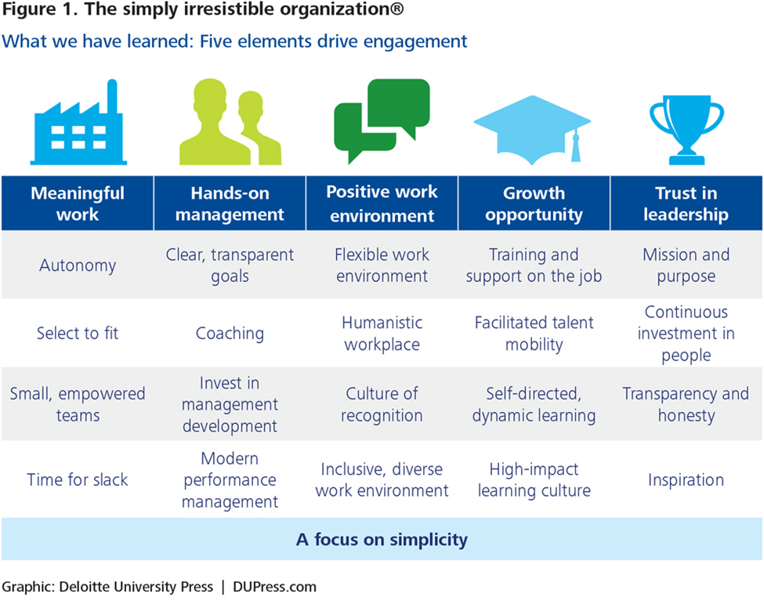
Becoming Irresistible Culture
Source:
Bersin by Deloitte
Source:
Bersin by Deloitte

Slide 21
New HR Direction
(1)
Talent Management
People Management
Lifetime career management
Integration of individual lifestyle
Segment rank, rating per performance, potential
Progressive training to change behavior to rise in career lather
Rewards based on segmentation and performance
Movement & projects
Enhance work experience
Find strengths, empower to add value
Learning Environment for constant learning
Rewards based on people’s potential market value
Vs

Slide 22
New HR Direction
(2)
Talent Management
People Management
How can you add value?
Talent pools with segments and clusters for ease of management
Software to integrate all HR functions together – system of integration
Are you an owner?
Honor and embrace diversity, empower to thrive
Software that empowers people to do their job better – system of engagement
Vs
21st Century Economy = Purpose Economy = People Centric
Source: Bersin by Deloitte

Slide 23
Prominent Authors
Common Thread
Bersin
Strack
Jensen
Cultural Movement
Engagement Movement
Zigarmi
Zigarmi
Fowler

Slide 24
Trajectory

Slide 26
Purpose: The Integral Part of Existence
Personal
Organizational
Role
Define
Decide
Develop
Job
Career
Purpose
Sweet
Spot
Ethical
Deliver
Serve
Delight
Engage
Source:
“The Purpose Effect”, by Pontefract

Slide 27
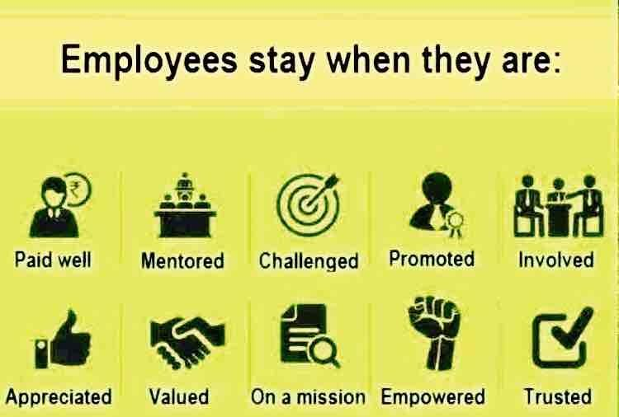

Slide 28
Young!
MAKE
DIFFERENCE
SERVE
SPIRITUAL
MEANING
FULFILLMENT
CREDIT
FOR MERITS
CONNECTION
SOCIAL
$$$
$$$
BE REMEMBERED
ABUNDANCE

Slide 29
SELF ACTUALIZATION
Autonomy
Relatedness
Competence
[ARC]
Mindfulness
Purpose
Values
[MPV]
Source:
“Optimal Motivation” Program, by Fowler et al, The Ken Blanchard Companies; adapted from Maslow’s Hierarchy of Needs

Slide 30
Source: LinkedIn

Slide 31
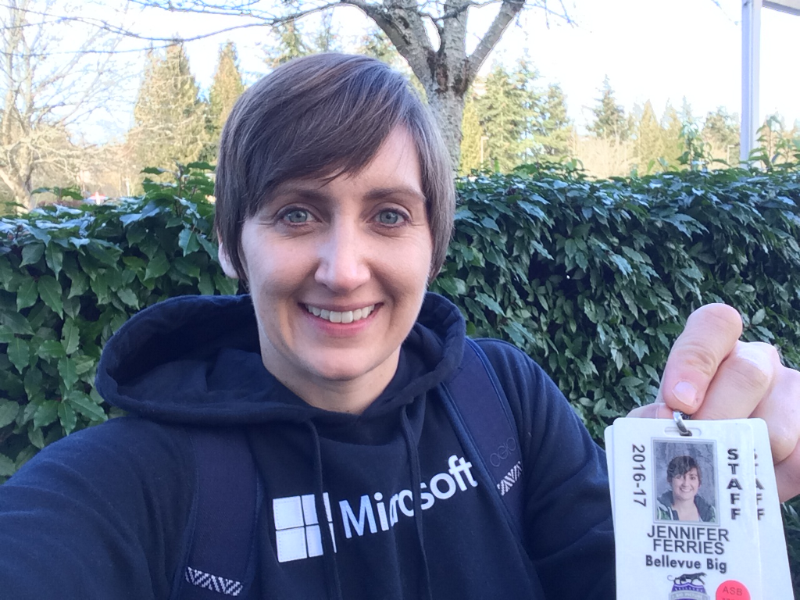
Source: LinkedIn

Slide 32
Purpose Driven
Organizations
Source: The Blue Economy.com
Recycling Coffee Waste for Mushrooms

Slide 33
Beer Brewing Zero Emissions

Slide 35
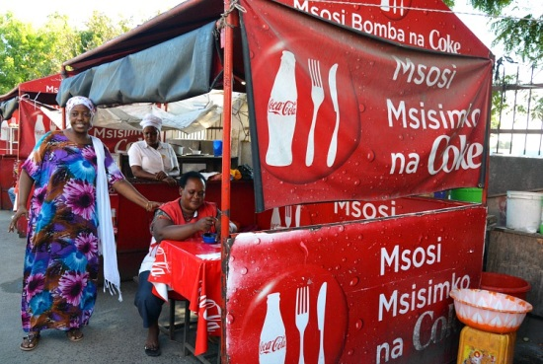

Slide 37
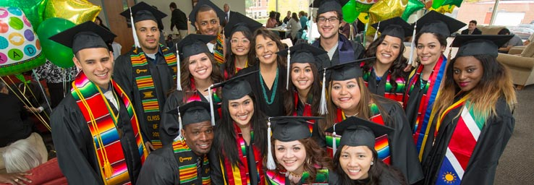
Education
Connection with Source

Slide 38
What Is Your Purpose?

Slide 39
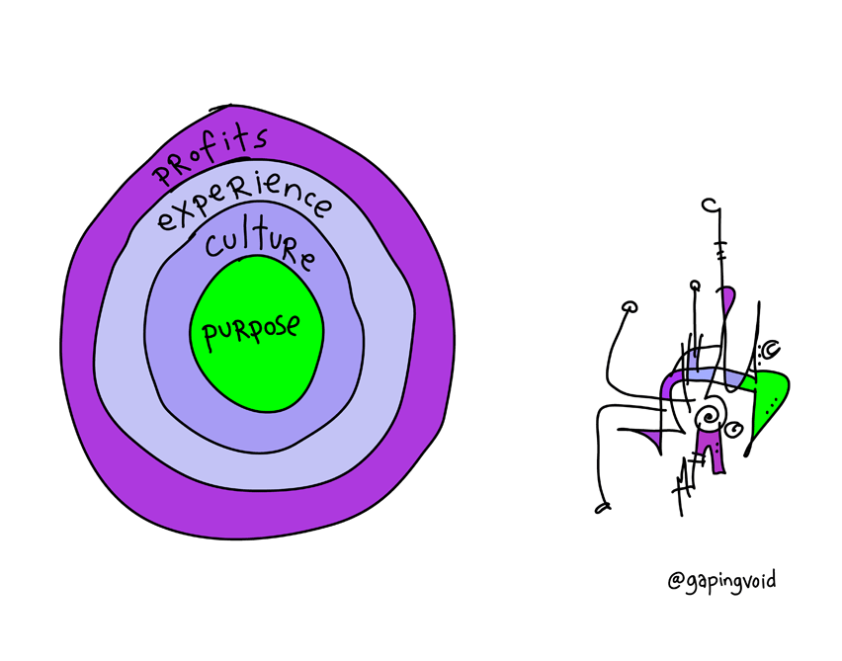
Passion . Productivity . Profit
Triple Bottom Line
From Talent To People Management!
The Purpose Economy
Workforce Crisis 2030
Collaboration & Recognition
People Centric & Strengths
Shared Value
People Driven Culture

Slide 40
Q&A
Please Send: Questions, Comments, Discussion to…
Email:
OnPurposePM@gmail.com
LinkedIn > Group
People Management: On!Purpose

Slide 41
Thank YOU very much!
Maria Pressentin
LinkedIn:
Https://sg.linkedin.com/in/marializpressentin

Slide 42
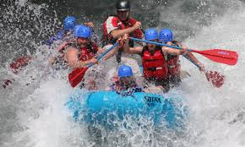
‘You cannot beat a river into submission.
Surrender to its power and use its power as your own.’
- The Ancient One, Dr. Strange

Slide 43
References
(1) Books
Achieve Leadership Genius, Zigarmi
Future of Work, Morgan
The Blue Economy, Pauli
The Performance Prism, Neeliyet al
The Fifth Discipline, Senge
Why Motivating People Does’nt Work and What Does?
Leading from the Emerging Future Scharmer
Corporate Entrepreneurship, Hisrich et Kearney
The Purpose Effect, Pontefract
The Purpose Economy, Hurst
The Story of Purpose, Reiman

Slide 44
References
(2) Articles
Why People Mgt is Replacing Talent Mgt., Bersin by Deloitte
Beyond Engagement: Toward a Framework and Operational Definition for Employee Work Passion, Zigarmi et al
2030 Global Workforce Crisis, TED, Strack
Is it Time to Rethink Maslow’s Hierarchy of Needs?, The Ken Blanchard Companies, Fowler
What Leaders Need to Know About Generational Differences, The Ken Blanchard Companies
Employee Work Passion: A New Look at Engagement
What could be more crucial to your organization’s performance than the choice and cultivation of its future leaders? Why, then, do traditional succession plans so often fail? Because great leadership at the top of your organization actually begins in the middle, Conger et Fulmer
The Ken Blanchard Companies: Legendary Service, Halsey& Kuff, Leaderhsip Profit Chain, Zigarmi et al

Slide 45
References
(3) Articles
Creating a Dynamic and Sustainable Talent Ecosystem, Chandrasekar et Zhao
The 'On-Demand Economy' Is Revolutionizing Consumer Behavior — Here's How, Jaconi
Quantified Self: Meet the Quantified Employee, Bersin by Deloitte
Training Bottom Line, Gordon
The New Competitive Advantage: Creating Shared Value, Porter
Testing the Social Innovation Construct: An Empirical Approach to Align Socially Oriented Objectives, Stakeholder Engagement, and Environmental Sustainability, Segarra-Oña,Peiró-Signes,Albors-Garrigós,Miguel-Molina
Social Innovation: Blurring Boundaries to Reconfigure Markets, Nicholls et Murdock
The Business Case for Education to Include Soft Skills on the Systemic Level: Reflection on Being a Culturally Responsive Educator In Higher Education, Pressentin
Ingredients for Social Innovation Business: Trends . Leadership . Action Plan, Pressentin

Slide 46
On!Purpose
People Management
ABOUT THIS GROUP
The intention of this group is to discuss and uncover ways to enhance the People Management Triple Bottom line, as we get ready to enter the Purpose Economic era, to bring about ideas how to shape the mindset of our organizations and leaders to pay attention to creating Shared Value and Purpose driven work for employees. There is a lot of money left of the table if shared value between companies and societal needs-gap are not addressed. Shared value substantially increases new ways of going-to-market - it is an abundance mindset that organizations need to get used to. We will be facing a workforce crisis soon that has already shown up as retention and succession problems for the past decade in talent management practices. By 2025, 75% of the workforce is made up of Millennials. An urgent strategic plan from organizations, governments and communities is needed enhanced collaborative efforts. As business and human resources leaders, we can innovate through this discussion group to make a difference and influence the organizations we work for, even without authority!

